Slide 1

Scrapy Project: S&P 500 Investment Search
Feb 15 2021

Slide 2
Overview
Objectives:
Generate a short list of stocks that warrant research for potential investment
Exploration of the scraped data to identify useful or interesting information
Websites scraped:
finance.yahoo.com & wikipedia
Data:
Diverse stock information for all S&P 500 companies as of Feb 11th, 2021
Stock price related information: PE, 1y analyst estimates, dividends, beta, etc.
Company financials: ROE, ROA, Profit margin, current ratio, etc.
Governance Scores: Environmental, Social and Governance (ESG)
From Institutional Shareholder Services (ISS) and Sustainalytics
Notes:
One of my favorite websites for pulling up stock info. One of yahoo’s best features
Use mix of selenium and scrapy
This made for a very wide (feature rich) dataframe

Slide 3
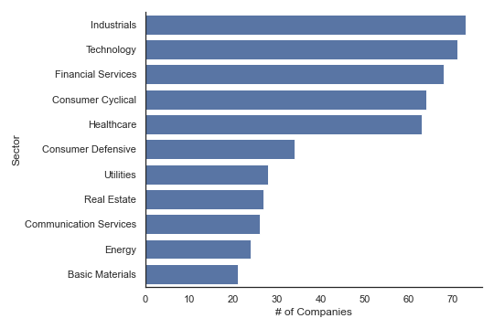
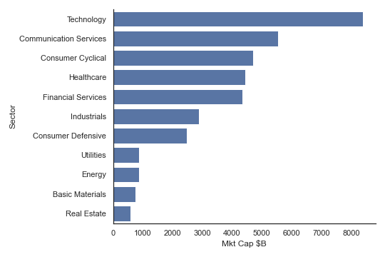
The S&P 500
Overview of the group (median, mean):
PE Ratio: 29, 47
Market Cap: $28B, $72B
# Employees: 20K, 60K
Notes:
Why the spx?
Reliable companies.
Not likely to go bust on you
Good choice for LT investing
More reliable financials….sort of
Good analyst coverage
Adequate size

Slide 4
Stock Search - Methodology
Inspiration: The Intelligent Investor by Benjamin Graham
Generally a conservative/defensive approach
Seek companies with:
good fundamentals, dividends, moderate price ratios and adequate size
Bottom-up: find top contenders along the following categories and cross reference:
Operating Figures: current ratio, operating margin, profit margin, ROA, ROE
Reasonable market valuations: PE, PEG, Price-to-sales, Price-to-revenues, EV-to-Rev, EV-to-EBITDA
Governance scores (ESG and ISS)
Good dividends
Consensus 1-year Analyst Estimates for 2021
Top-down: which sectors are most attractive?
Utilize above mentioned categories on the sector groups
Notes:
Inspiration:
Father of value investing
Don’t lose capital
Avoid the flashy companies and the ones you don’t understand
Long-term perspective. Antithesis to gamestop
Diversity
Bottom-up:
Was hoping for a eureka where all categories could be cross-ref’d to arrive at a magic list, but no such luck
Found that these criteria were often mutually exclusive
Used quantile approach and merging of like ratios/data
Was very interested in the governance scores, because not sure where else you can get all of them in one place
Must take consensus estimates with a huge grain of salt. Things to consider, # of analysts, quality of analysts, they’re often wrong
Good dividends, very defensive posture, consistent div flow is not to be understated

Slide 5
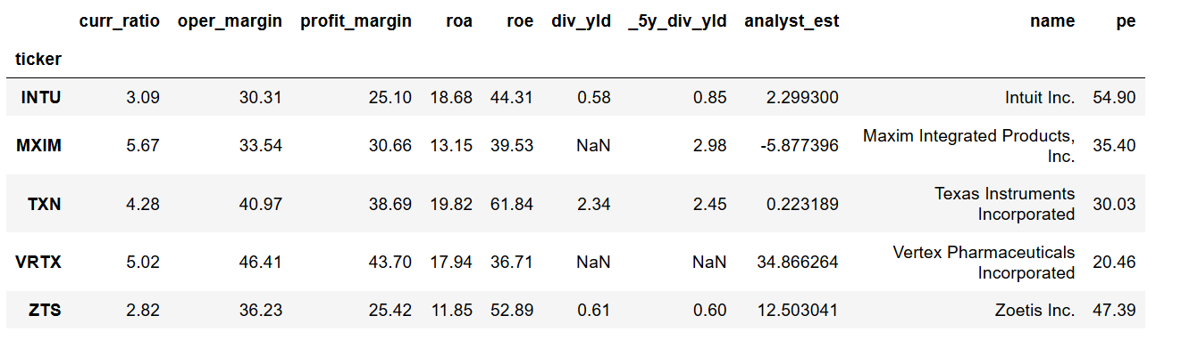
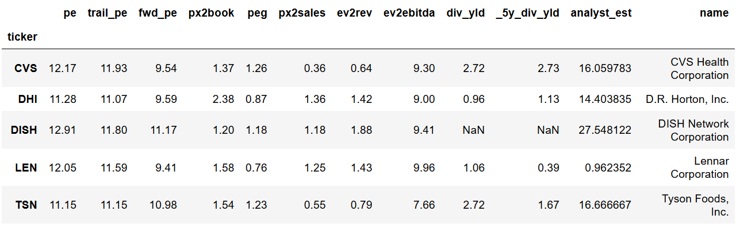
Stock Search – Bottom-up (company)
Operating Figures: current ratio, operating margin, profit margin, ROA, ROE
Reasonable market valuations: PE, PEG, Price-to-sales, Price-to-revenues, EV-to-Rev, EV-to-EBITDA
Notes:
Vertex – pharma - cystic fibrosis. Very rosy analyst estimates
Zoetis – healthcare, vaccines, etc. PE looks quite high, but maybe worth a look
CVS – decent div and estimates
Dish – good estimates
TSN – good estimates

Slide 6
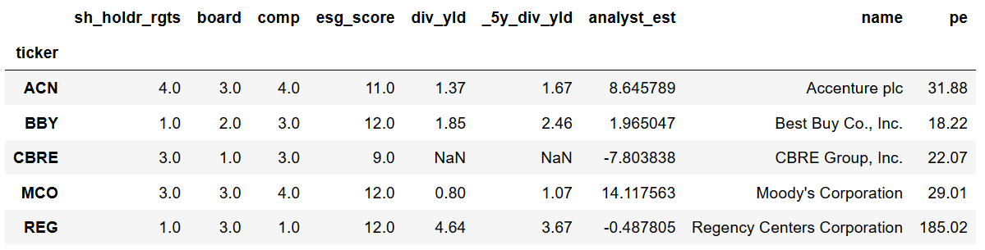
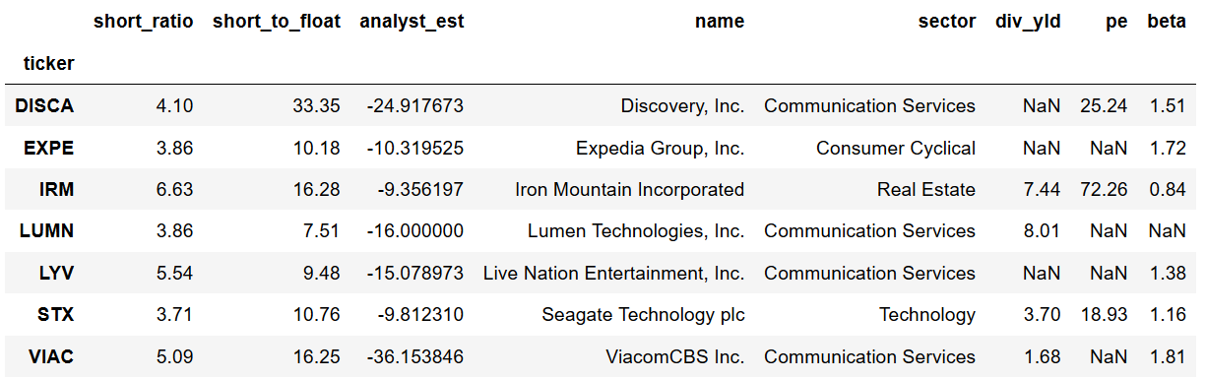
Stock Search – Bottom-up (company)
Governance scores (ESG and ISS)
Stocks to short? Based on ‘short’ data and bearish 1y analyst estimates

Slide 7
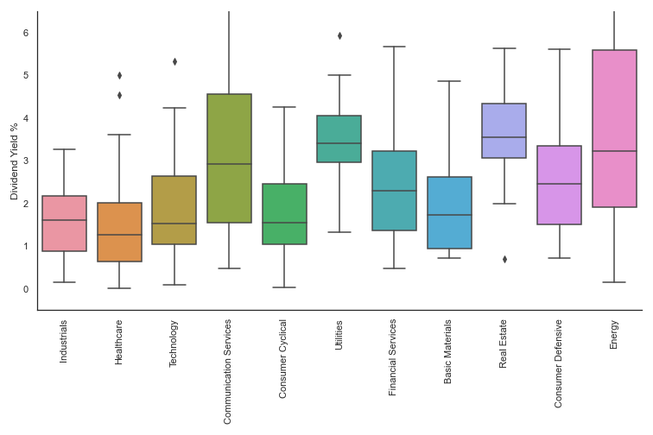
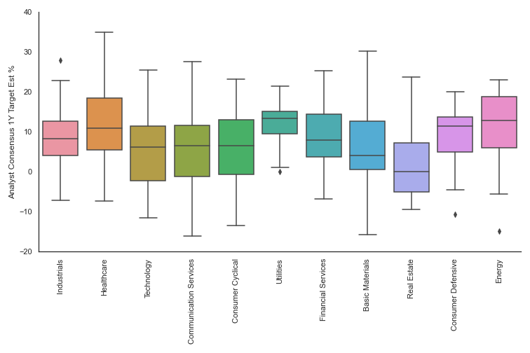
Stock Search – Top-down (Sector)
Analyst 1y Estimates
Dividend Yield

Slide 8
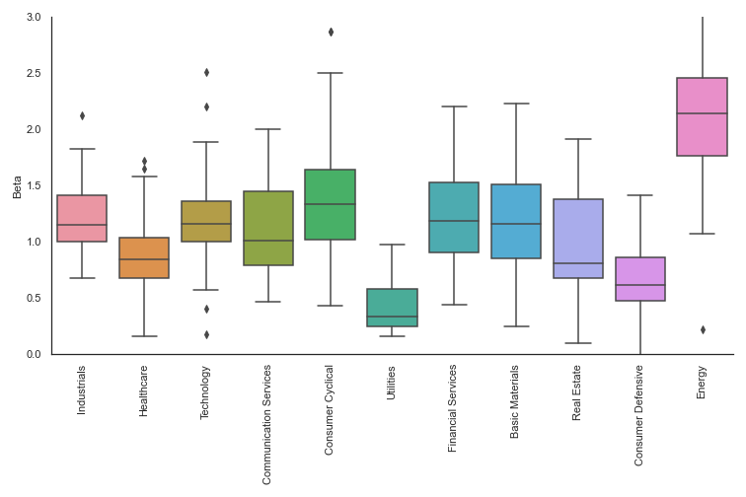
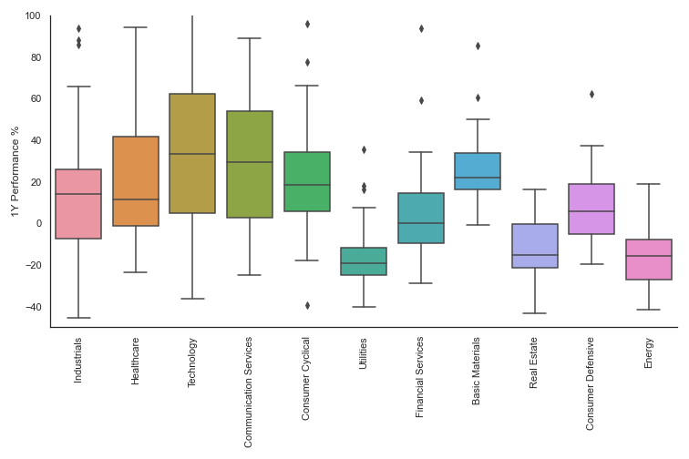
Stock Search – Top-down (Sector)
1 Year Price Change (Feb’19 – Feb’20)
Beta

Slide 9
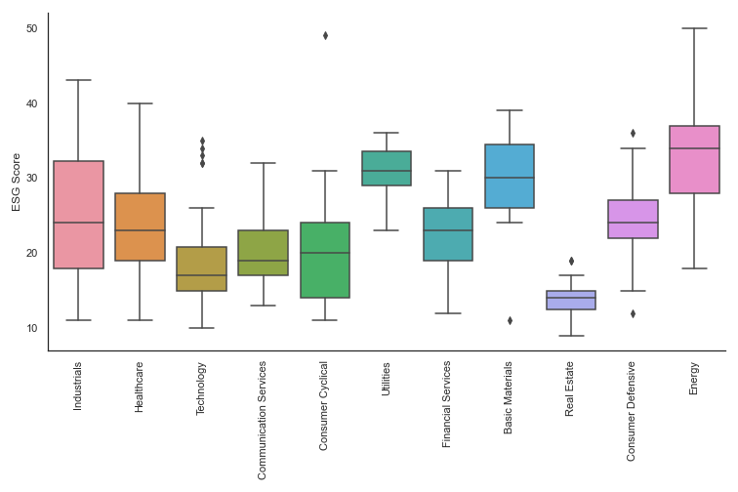
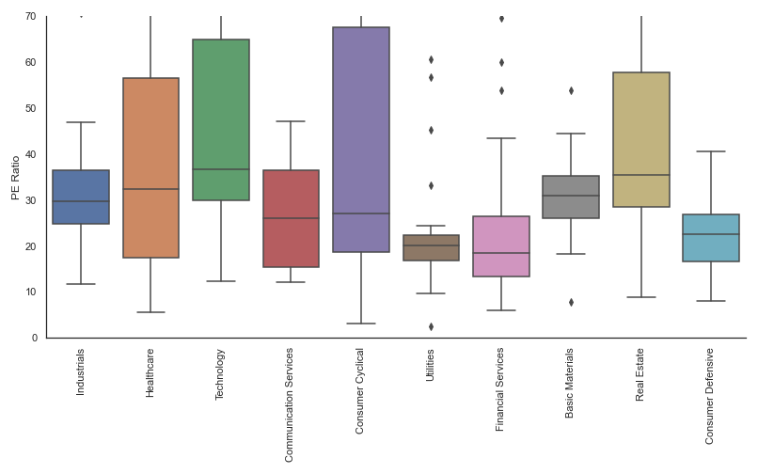
Stock Search – Top-down (Sector)
The Utilities sector looks interesting based on the data, but the ESG should be considered
PE Ratio
ESG Score

Slide 10
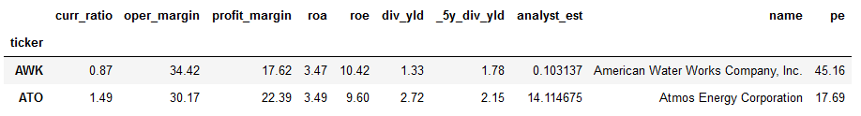
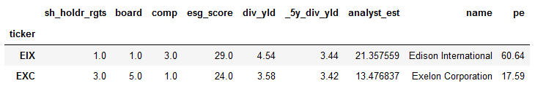
Utilities Sector – Bottom-up (company)
Operating Figures: current ratio, operating margin, profit margin, ROA, ROE
Reasonable market valuations: PE, PEG, Price-to-sales, Price-to-revenues, EV-to-Rev, EV-to-EBITDA
Governance scores (ESG and ISS)

Slide 11
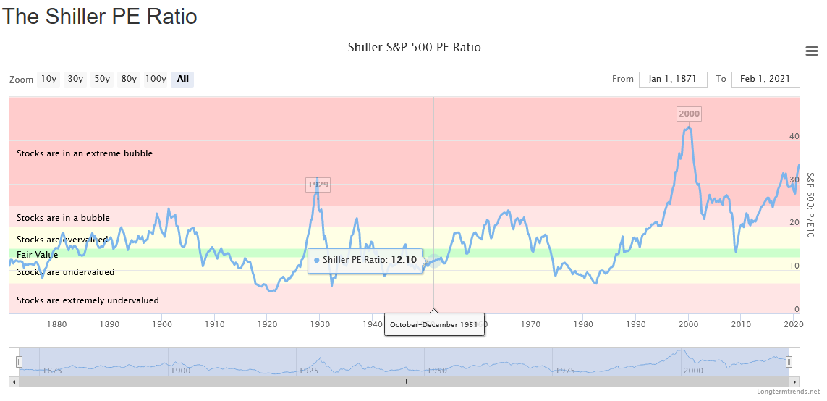
Final Thoughts
Are we in a bubble?
Perhaps more reason to currently be defensive and conservative.
Source: https://www.longtermtrends.net/sp500-price-earnings-shiller-pe-ratio/

